Slide 1
Assignment 1 Linear Systems and Approximations
Nusair Islam

Slide 2
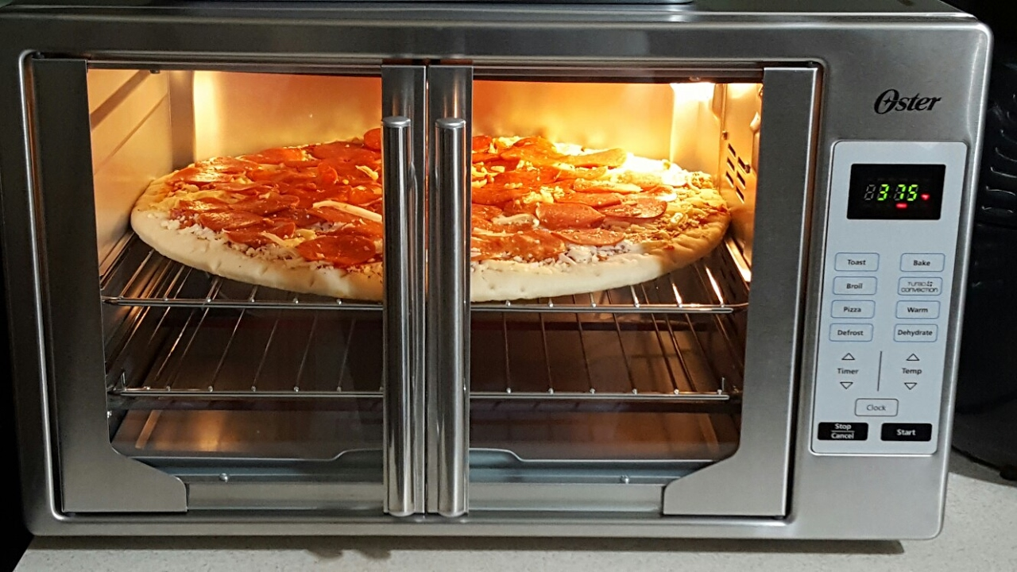
1. Control Systems – Oven
FIRST LOOK Oster XL French Door Convection Oven Pizza [Digital image]. (n.d.). Retrieved from https://www.youtube.com/watch?v=Qv3kL6ePjNk

Slide 3
1. Control Systems – Oven
Plant
Input
Temp
Controller
Desired
Temp
Interior Temperature
Temperature Dial
Heating System
Input
Signal
Output
Signal
Sensor
Thermometer

Slide 4
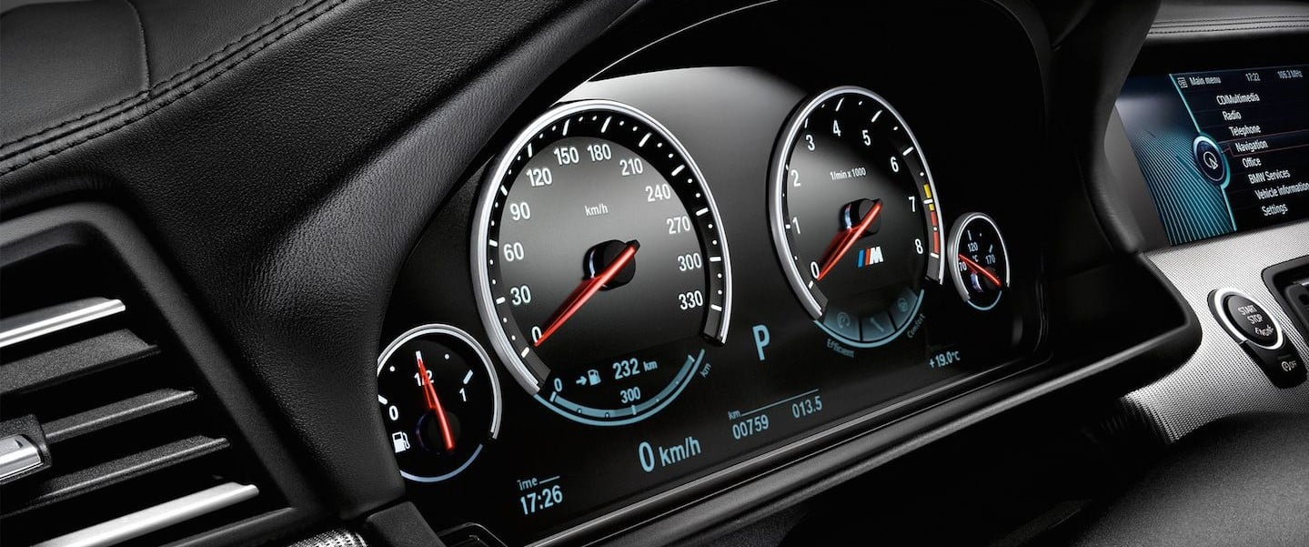
1. Control Systems – Car Speed
Mason, S. (n.d.). How accurate is your car speedometer? [Digital image]. Retrieved from https://www.thecarexpert.co.uk/how-accurate-is-a-car-speedometer/

Slide 5
1. Control Systems – Car Speed
Input
Speed
Controller
Plant
Desired
Temp
Accelerator
Car Engine
Input
Signal
Output
Signal
Sensor
Speedometer/
Tactile measurement

Slide 6
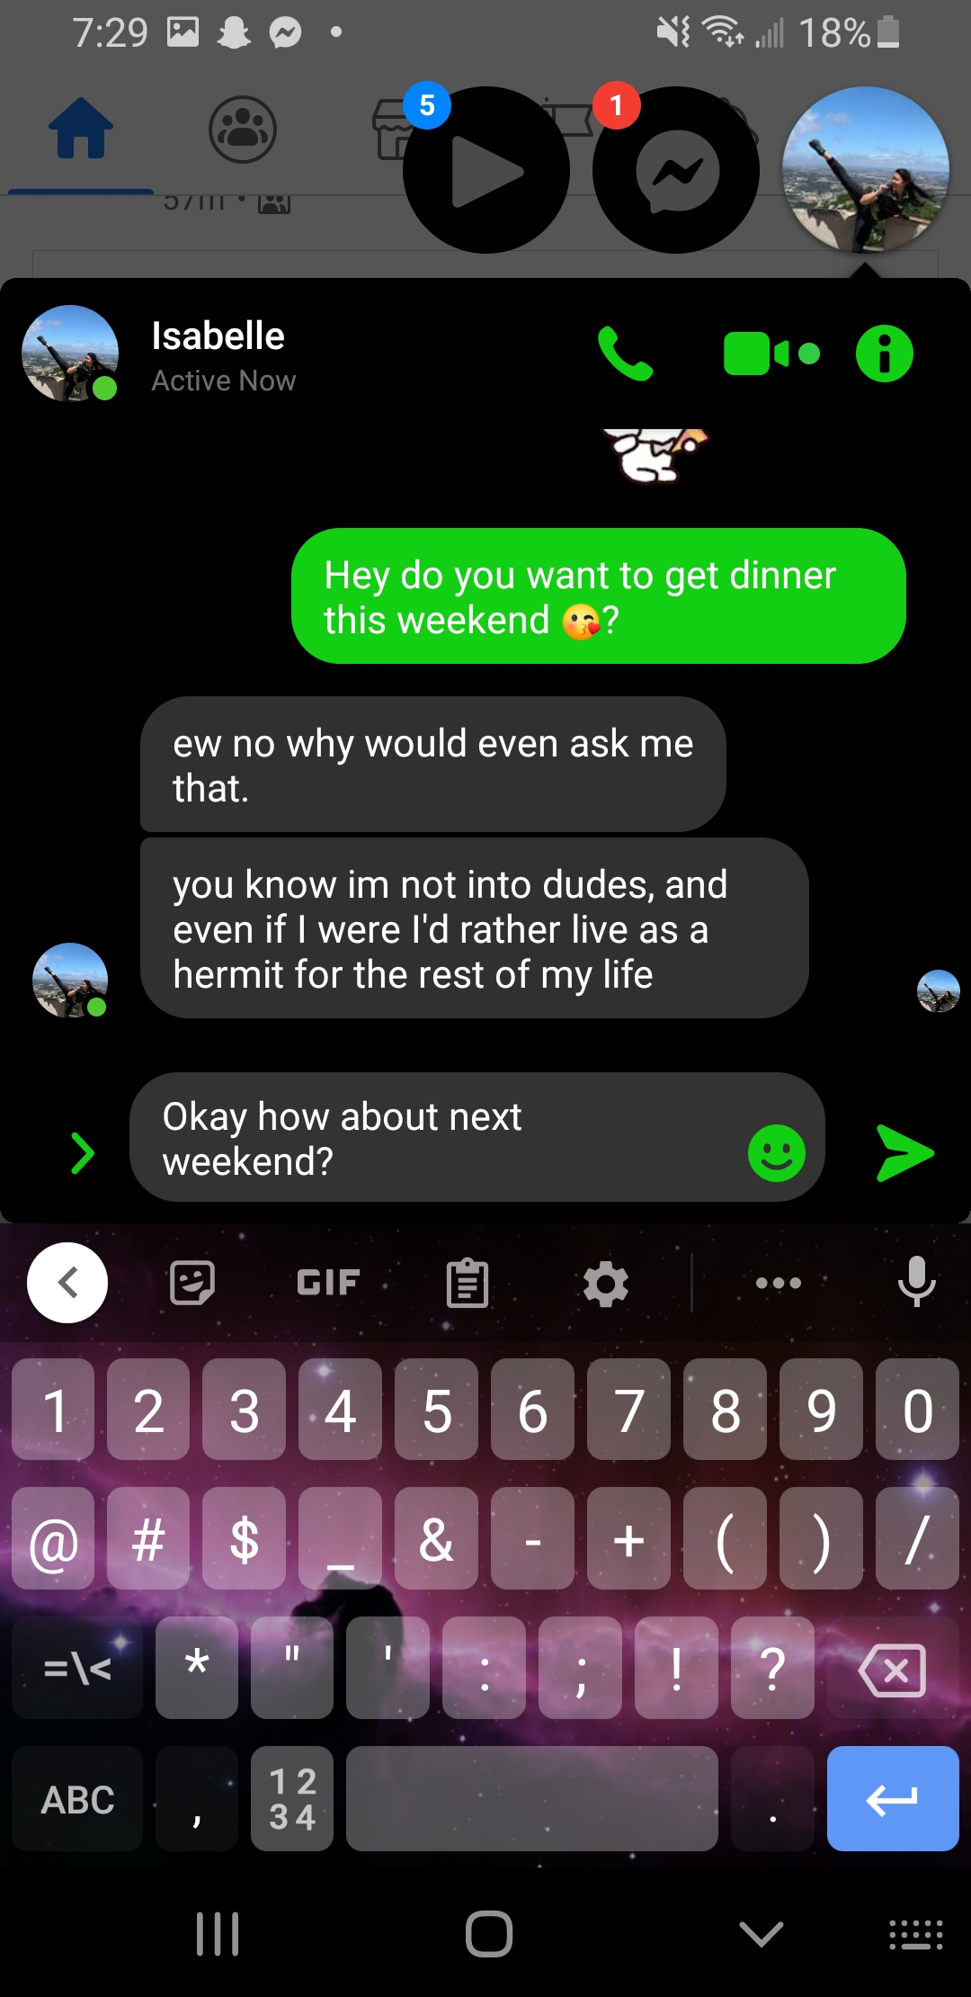

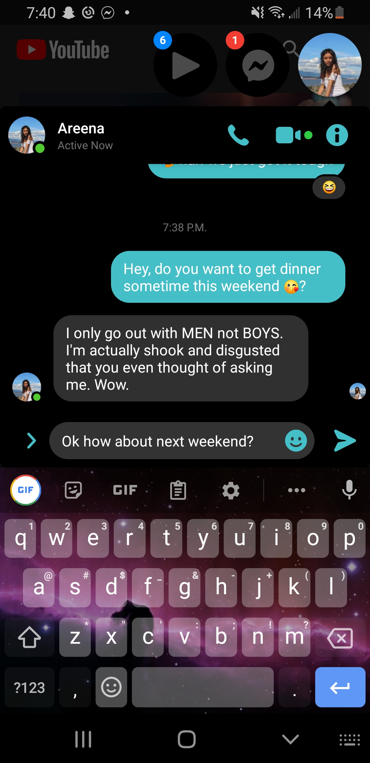
1. Control Systems – Asking a Girl Out

Slide 7
1. Control Systems – Asking a Girl Out
Plant
Controller
Desired
Outcome
Desire
Text Message
Girl’s Feelings
Reply
Input
Signal
Output
Signal
Sensor
Re-Evaluation/
Desperation

Slide 8
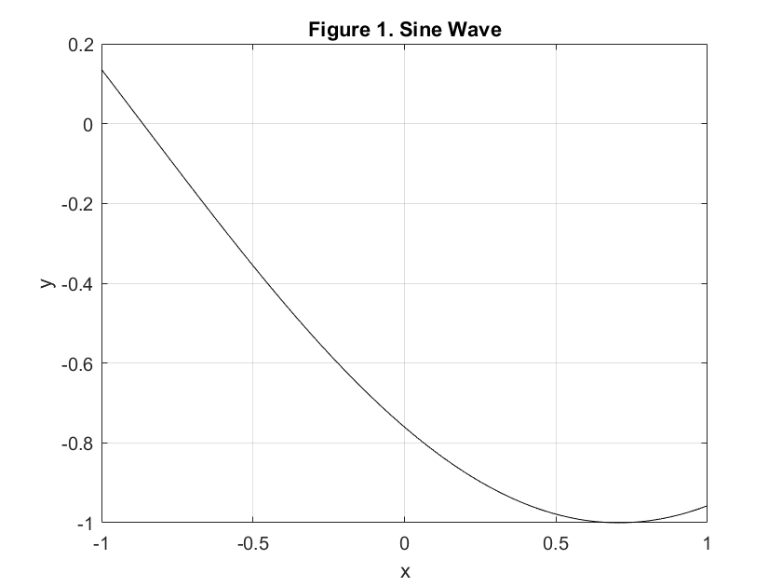
2. Plot sine wave

Slide 9
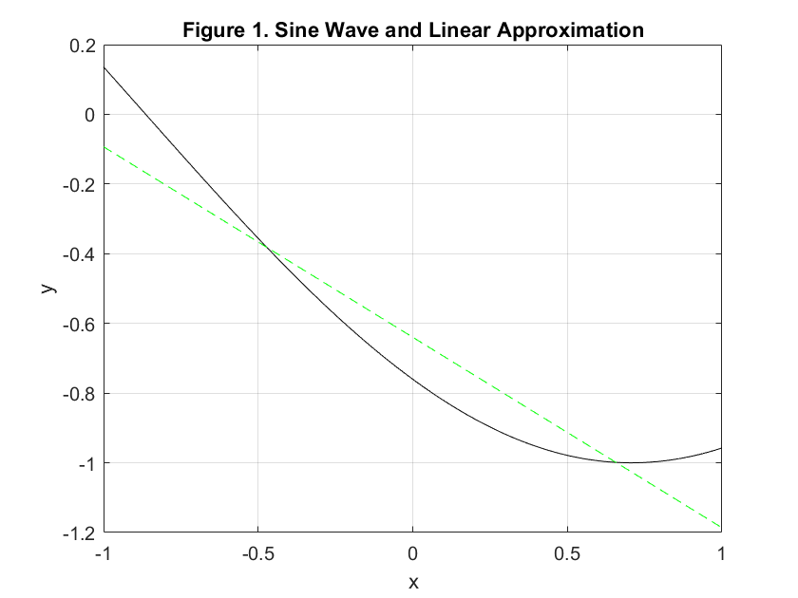
3. Plot linear approximation of sine wave segment

Slide 10
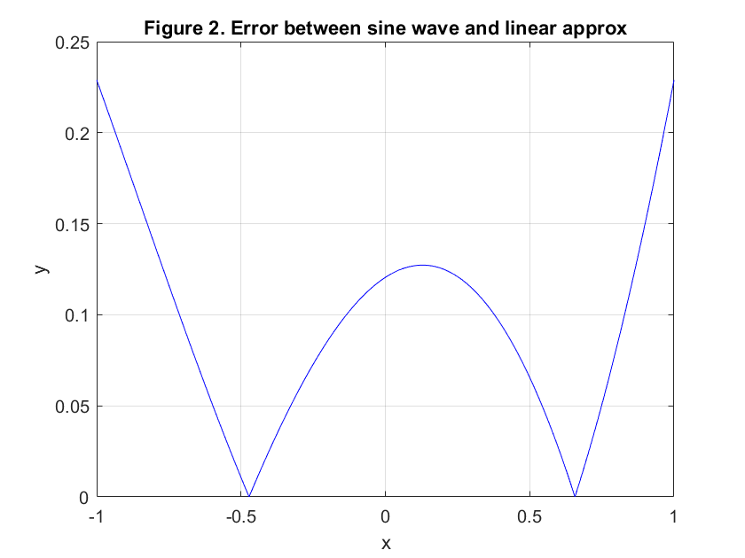
4. Plot the error between the sine wave and linear approximation, absolute value

